Slide 1
Quality Improvement workshop # 3
UB IM Training Program
Regina Makdissi, MD FACP SFHM
Erin Conway, MD
Associate Program Director for QI and Patient Safety
Notes:
Workshop 3: Measurement and PDSAs
Family of Measures
Measurement of bananas for operational definitions
http://www.ihi.org/education/IHIOpenSchool/resources/Pages/AudioandVideo/QI-Games-How-Do-You-Measure-the-Banana.aspx

Slide 2
QI WORKSHOP APPROACH
QI TOOLKIT
Project Charter- Part 1
Stakeholder Register Template
Identify Problem
Flow Chart Template
Document Current Process
QIToolkit- FMEA
Macros Pareto Chart
Macros Fishbone RCA
Five Whys Root Cause Analysis
Identify & Analyze Process Failures
Identify Root Causes
Project Charter- Part 2
IHITool_Aim_Statement
Develop SMART AIM and Measures
IM Residency KDD
Identify Key Drivers
Run Chart Template
Macros Control Chart Template
DOM PDSA Tracking Template
Identify, Design and Execute PDSAs
Scale up Successful Interventions
Plan for Sustainability & Spread
Erin Conway MD, UBMD IM
Notes:
Recap of the QI tools available on UB Learns
Regina and Zac have access on UB Box “QI Toolkit”

Slide 3
Process, balance, and outcome measures

Slide 4
Why do Measures Matter?
Measures allow you to demonstrate the effectiveness of your interventions and change and determine if the changes you are making are actually leading to improvement
It’s critical to use a “family of measures” to monitor the effectiveness of your project and ensure that new problems are not stemming from your interventions

Slide 5
Types of Measures- Outcome Measures
Outcome Measures = monitoring of progress towards your aim
Outcome measures should demonstrate how the change is affecting the end-result
Examples used by IHI:
For diabetes: Average hemoglobin A1c level for population of patients with diabetes
For access: Number of days to 3rd next available appointment
For critical care: Intensive Care Unit (ICU) percent unadjusted mortality
For medication systems: Adverse drug events per 1,000 doses

Slide 6
Types of Measures- Process Measures
Process Measures = monitoring of specific interventions
Process measures should demonstrate how systems are operating and how well you are delivering the change that you want to make
Examples used by IHI:
For diabetes: Percentage of patients whose hemoglobin A1c level was measured twice in the past year
For access: Average daily clinician hours available for appointments
For critical care: Percent of patients with intentional rounding completed on schedule

Slide 7
Types of Measures – Balance Measures
Balancing Measures = monitoring the periphery
Balance measures will help to ensure you are not introducing unintended consequences as you delivering change
Examples used by IHI:
For reducing time patients spend on a ventilator after surgery: Make sure reintubation rates are not increasing
For reducing patients' length of stay in the hospital: Make sure readmission rates are not increasing

Slide 8
Process Measure
Process Measure
Process Measure
Outcome Measure
What you do
Keeping things in check
Keeping things in check
Balance Measure
Balance Measure
What you get

Slide 9
Average Starbucks wait time
Number of days left house by 8am
Average daily drive time
Decrease Late Arrival to Work
What you do
Keeping things in check
Keeping things in check
Number of speeding tickets
Average gas mileage
What you get

Slide 10
Measurement for Research vs Improvement

Slide 11
Develop a Measurement Plan
The QI team should agree on the following for each measure:
Name of measure
Type of measure
Why is the measure needed?
What will be measured?
How often will data be collected?
Who will measure it?
How will results be tracked?
How will results be communicated to stakeholders?

Slide 12
Measurement Tips
Develop measures from data that is already being collected
Use sources that are easily accessible
If you cannot pull data from an established source, collect data in real time by incorporating it into a current work activity
For example, if an office is already collecting patient information in a flowsheet, add the relevant item into that flowsheet
Provide operational definitions
Specify unambiguously how to derive each measure
Makes it easy for any to duplicate or immediate know how and what you are measuring
Aim to collect data on 5-7 measures, but no more than 10 measures
Adding too many measures can become cumbersome and shift the focus from improvement to measurement
Notes:
Adapted from IHI

Slide 13
Small Group Activity
http://www.ihi.org/education/IHIOpenSchool/resources/Pages/AudioandVideo/QI-Games-How-Do-You-Measure-the-Banana.aspx

Slide 14
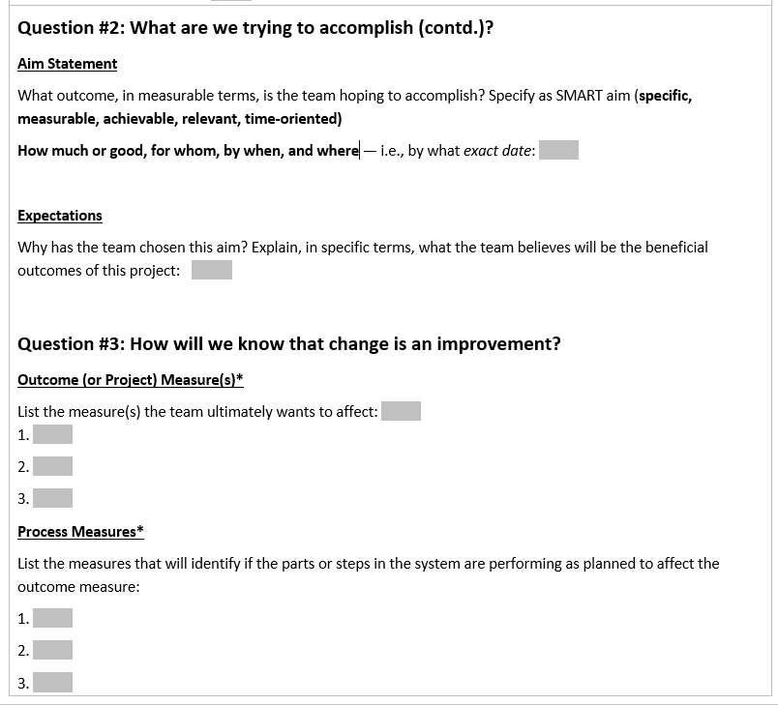
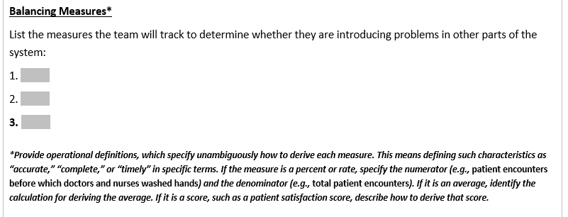
QI Toolkit: Project Charter Part 2
Notes:
This is to remind residents to utilize Part 2 of Project Charter in the QI toolkit (on UB Learns)
to facilitate the development of their SMART aim and measures.

Slide 15
SMART AIM
Every AIM should be SMART ;)

Slide 16
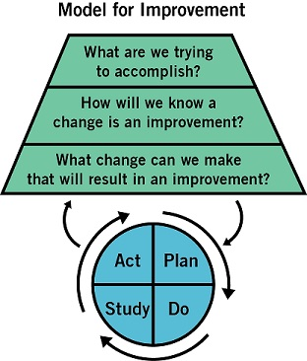
AIM Statement
The answer to the first question in the MFI
A good aim is specific, measurable, and addresses these questions:
How good?
By when?
For whom (or what system)?
Langley GL, et al. The Improvement Guide: A Practical Approach to Enhancing Organizational
Performance. 2nd ed. San Francisco, California: Jossey-Bass Publishers; 2009.
Notes:
We just won’t improve without a clear and firm intention to do so. We need an aim.
Should be succinct and not contain extraneous background information or side issues

Slide 17
AIM Statements
Global Goal ≠ SMART AIM
AIM statement helps team focus its efforts, keep appropriate scope of activities, and reduce variations from original purpose
Succinct and not contain extraneous background information or side issues
Able to easily understand exactly where you’re going and what you expect to accomplish
Indicates your goal as well as the baseline to clearly define what you are trying to achieve
Could try forever and never get there, because it’s not clear where “there” is
Gives a time frame for the work

Slide 18
AIMS are SMART
S - specific (clearly stated, defined population)
M - measurable (numeric goals)
A - achievable (within your control/influence)
R - relevant (aligned with organization’s priorities)
T - time-oriented (time frame)

Slide 19
Components of SMART Aims
Specific Population | Reduces unwanted variations, keeps team focus
Increase or Decrease | How are you measuring? Operational definition (reduces unwanted variations)
From | What is the baseline?
To | What is the goal?
By When | What is the time frame for improvement?

Slide 20
QI Toolkit: Project Charter Part 2

Slide 21
Change ideas
Failure and Root Cause Analysis

Slide 22
Coming Up with New Ideas for Change
Innovation — coming up with new ideas for change | Pilot — testing a change on a small scale | Implementation — making the change the new standard process in a defined setting | Spread — implementing the change in several settings
The complete “life cycle” of an improvement project contains four distinct phases:
QI Tools help generate a hypothesis (Theory of Change)
How does the team learn more about the process or system?
What are the causes of current QI problem- NOT solutions?
Notes:
This is where we are in the “life cycle of an improvement project
We are in the 1st phase

Slide 23
Using QI Tools for Ideas for Change
Critical thinking about the current system
Gather and analyze data on the way system currently works
Ex: Flowcharts, Failure Modes and Effects Analysis (FEMA), Root Cause Analysis
Benchmarking
Comparing your own process to “best practice” can help you identify where your own system falls short
Using technology
Often double-edged sword
Creative thinking
Identifying the boundaries that limit the changes you can make and then finding ways to dismantle those boundaries
Change Concepts- 9 Major Categories

Slide 24
Change Concepts:
1. Eliminate waste 2. Improve workflow 3. Optimize inventory 4. Enhance the producer-customer relationship 5. Change the work environment 6. Manage time 7. Manage variation 8. Design systems to prevent errors 9. Focus on the design of products and services
You can use this list as a jumping off point to develop specific ideas for
changes and you don't necessarily have to start from scratch
Notes:
9 Major Categories

Slide 25
Category of Change Concept | Description
Eliminate Waste | Eliminate any activity or resource that does not add value to an external customer.
Improve Work Flow | Important way to improve the quality of the goods and services produced by those processes.
Optimize Inventory | Inventory is a possible source of waste; understanding where inventory is stored in a system.
Change the Work Environment | Can be a high-leverage opportunity for making all other process changes more effective.
Producer/Customer Interface | To benefit from improvements in quality of products and services, the customer must recognize and appreciate the improvements.
Manage Time | Reducing the time to develop new products, waiting times for services, lead times for orders and deliveries, and cycle times.
Focus on Variation | Reducing variation improves the predictability of outcomes and helps reduce the frequency of poor results.
Error Proofing | Redesigning the system to make it less likely for people in the system to make errors. Make the information necessary to perform a task available, and not just in one's memory, by writing it down or by actually making it inherent in the product or process.
Focus on Product or Service | Also important to address improvement of products and services.

Slide 26
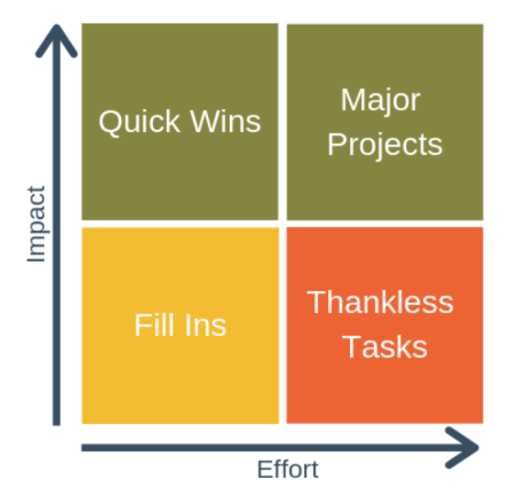
Priority Matrix for Interventions
Low hanging fruit!!
Start here!
Remaining and majority of time here
Spend ZERO time
Notes:
Six Sigma technique- focus on quick wins and major projects
To use the model, follow these four steps:
Make a complete list of all of your tasks.
Score your tasks for effort and impact. You can use any scale you like to do this, but a simple 1-10 scale works well, where one is very low, and ten is very high.
Place each activity in the matrix according to its effort and impact scores.
Prioritize your activities:
Give quick wins the highest priority.
Spend the remaining time on your major projects. You should spend the majority of your time on these tasks.
If you have any remaining time, do your fill-in activities. Otherwise, delegate or drop these tasks.
Eliminate thankless tasks. Spend absolutely zero time performing these tasks.

Slide 27
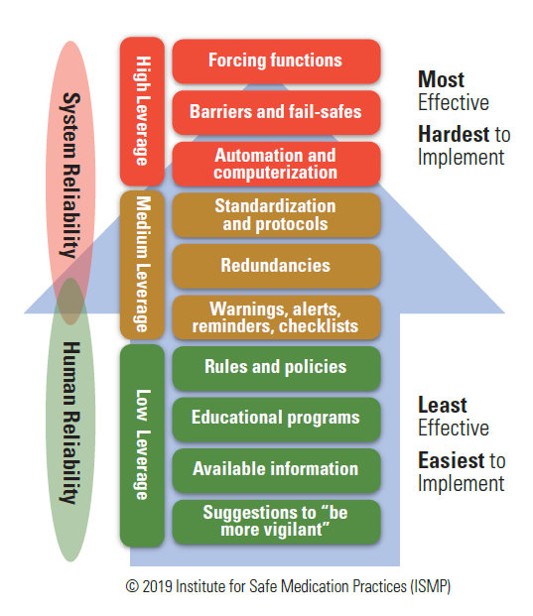
Hierarchy of Effectiveness
Notes:
Education and reminders alone to not tend to lead to meaningful change. Unlikely to meet your goal with these alone. Things get better for a bit and then they get ignored

Slide 28
PDSA CYCLES
The centerpiece of your “story”

Slide 29
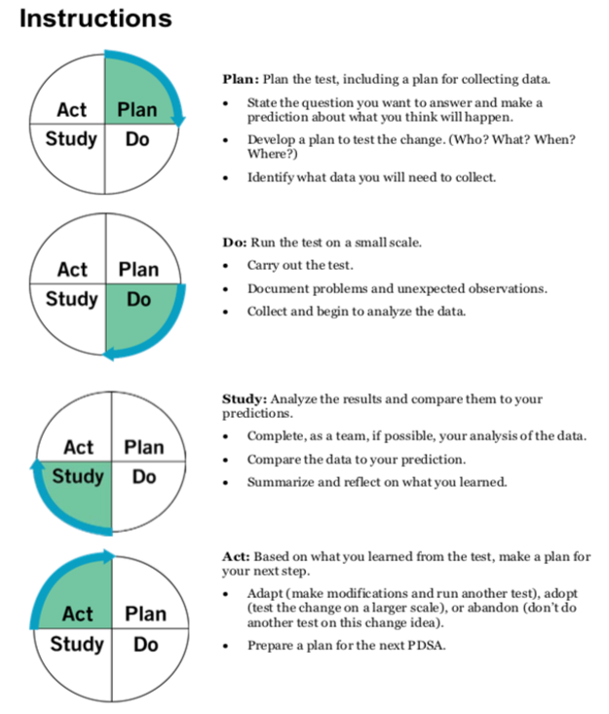
Planning for PDSAs
Notes:
Plan
Objectives, questions and predictions
Plan to carry out the cycle(who, what, where and when ), plan for data collection
Do
Carry out the plan , document problems and unexpected observations, begin data analysis
Study
Complete the analysis, compare data to predictions, summarize learning lessons
Act
What changes are to be made?
Next cycle

Slide 30
PDSA Small Group Activity:
http://www.ihi.org/education/IHIOpenSchool/resources/Pages/AudioandVideo/QI-Games-Learn-How-to-Use-PDSA-Cycles-by-Spinning-Coins.aspx

Slide 31
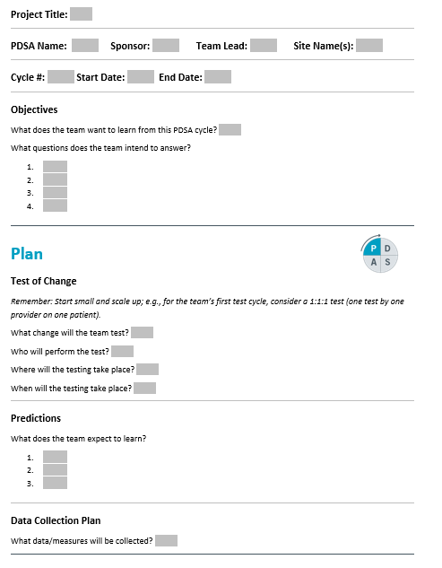
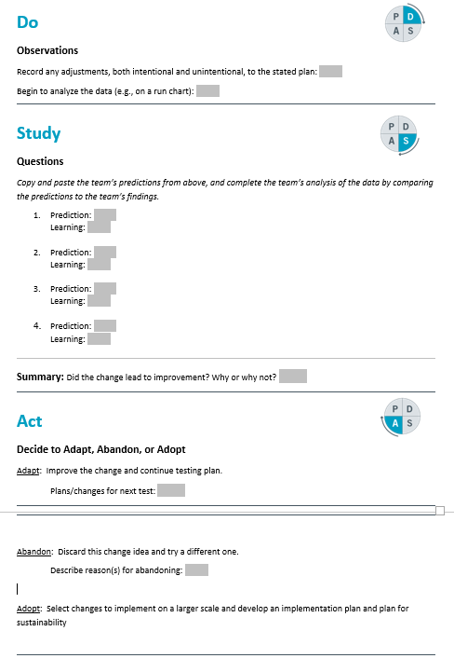
QI Toolkit: PDSA Planning Worksheet

Slide 32
References
Langley GL, Moen R, Nolan KM, Nolan TW, Norman CL, Provost LP. The Improvement Guide: A Practical Approach to Enhancing Organizational Performance. 2nd ed. San Francisco, California: Jossey-Bass Publishers; 2009.
IHI Open School Learning Modules QI102-104
Cincinnati Children’s Hospital Medical Center Rapid Cycle Improvement Course
QI Macros Software
Network for Improvement & Innovation in College Health
National Institute for Children’s Health Quality
IHI.org

Slide 33
Thank You!
Questions?
econway@buffalo.edu
Cell: 716-983-2347
krzobel@buffalo.edu

